Slide 1

https://xkcd.com/1954/

Slide 2
#Fcuk
Cancer

Slide 3

Why am I here?
Dealing with Imposter Syndrome
Notes:
Photo by Sander Sammy on Unsplash

Slide 4

Notes:
Photo by Daniel Schludi on Unsplash
Let me start this session with a story

Slide 5

Notes:
Many years ago
SQL Grill had new speaker track
Never spoken at technical conferences and wanted to speak

Slide 6

Notes:
Photo by AbsolutVision on Unsplash
Thought this would be really good for a friend of my to submit to the conference
They might have a different idea!

Slide 7

Notes:
Photo by Cytonn Photography on Unsplash
Made a deal if he submitted I would submit

Slide 8

Notes:
Photo by DS stories: https://www.pexels.com/photo/word-never-combined-of-scrabble-tiles-6005514/
Confident that my sessions would not get picked

Slide 9
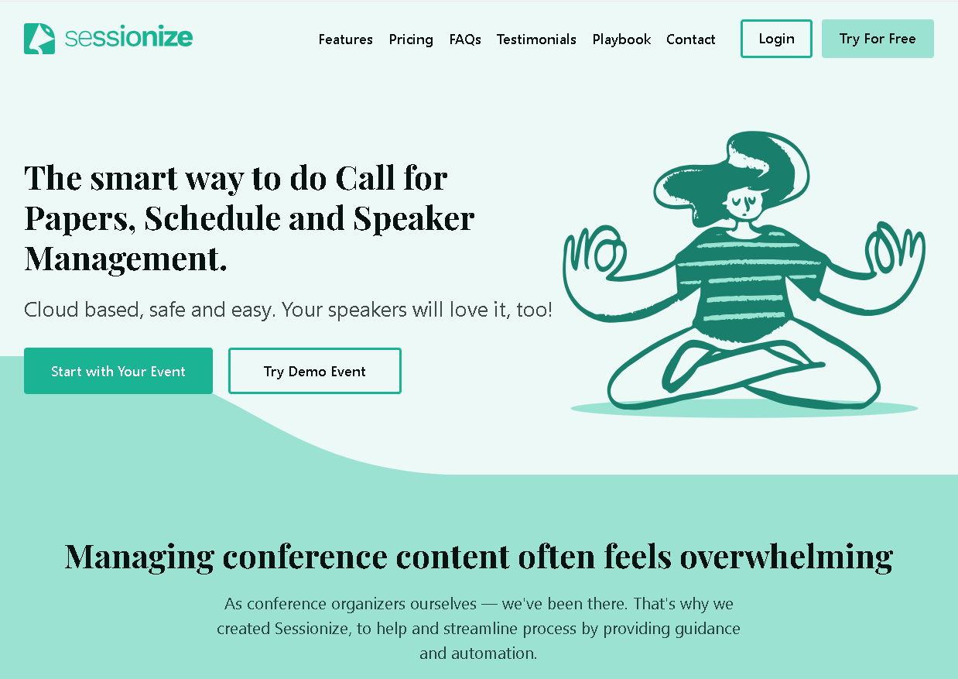
Notes:
So we submitted the sessions, I was confident they would never be picked

Slide 10

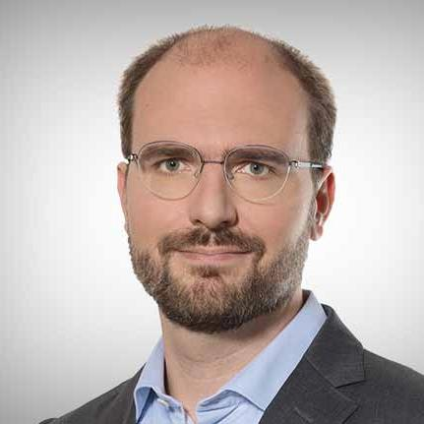
Notes:
William Durkin and Ben Wiessman and the selection committee had other ideas

Slide 11

Notes:
Photo by Miguel Á. Padriñán: https://www.pexels.com/photo/close-up-shot-of-keys-on-a-red-surface-2882686/
The selection committee said Yes !

Slide 12

Notes:
Photo by Andrey Metelev on Unsplash
So I panicked

Slide 13

Notes:
Photo by John Schnobrich on Unsplash
So I started planning my presentation

Slide 14
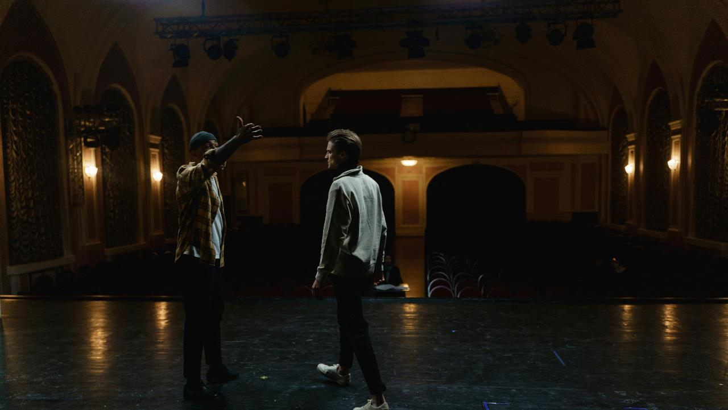
Notes:
Photo by cottonbro studio: https://www.pexels.com/photo/two-men-acting-on-stage-6896333/
So rehearsed,
Then rehearsed,
Then rehearsed and rehearsed

Slide 15

Notes:
Photo by Gianandrea Villa on Unsplash

Slide 16
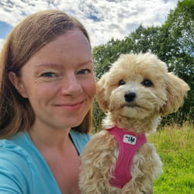

Slide 17

Notes:
Photo by Donald Tong: https://www.pexels.com/photo/person-doing-thumbs-up-193821/
Catherine was very kind and said keep doing what you are doing

Slide 18

Notes:
Photo by Lee Myungseong on Unsplash
At the speakers dinner again I felt like an imposter, yet so many people where very kind, and some said they were looking forward to my session.

Slide 19
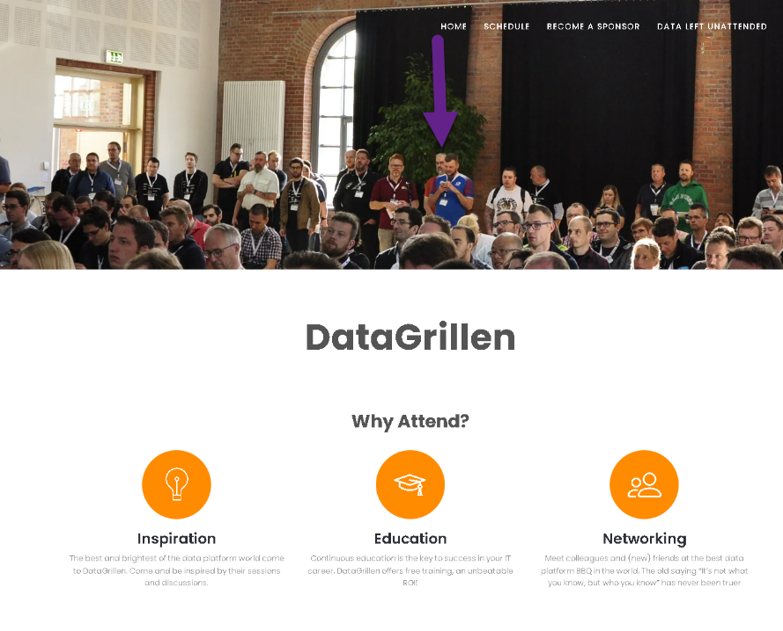

Slide 20

Notes:
Photo by Annie Spratt on Unsplash

Slide 21

Notes:
Photo by Yasser Mutwakil ياسر متوكل on Unsplash
In the speakers lounge I felt unworthy

Slide 22
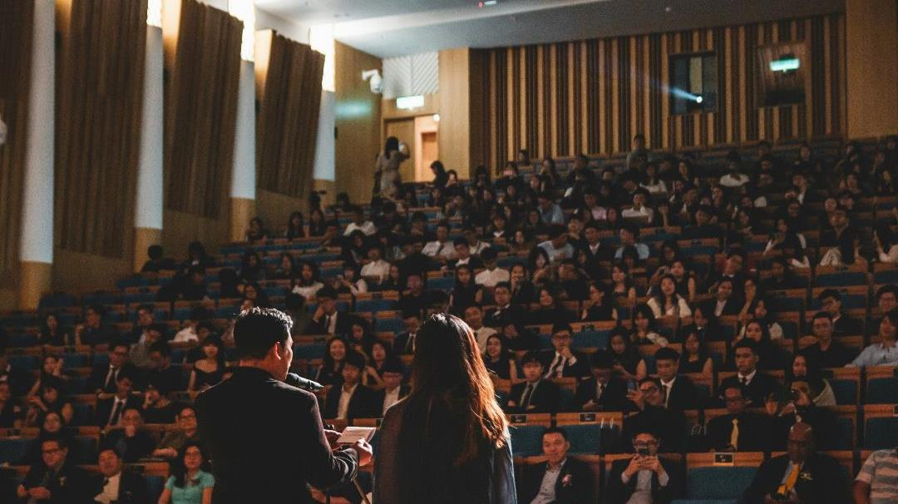
Notes:
Photo by Wan San Yip on Unsplash

Slide 23
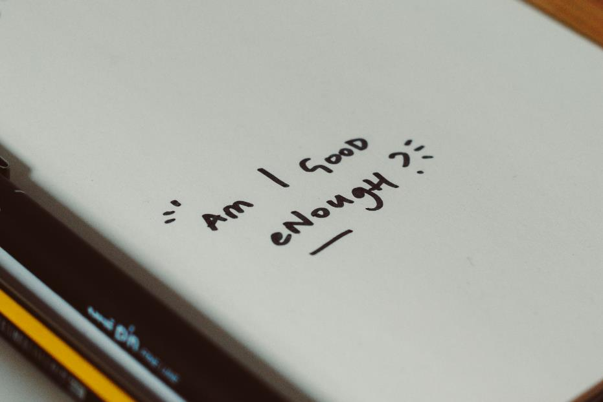
Notes:
Photo by Nik on Unsplash

Slide 24
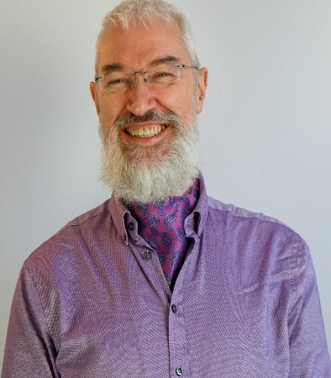




Robert French
Chief Power BI Nerd at Quorum
Lives in Sunny Glasgow, Scotland
rwlp.french@gmail.com
@sqlbobscot
https://www.linkedin.com/in/rwlpfrench/
https://www.qnrl.com/

Slide 25

Managed Services | Projects & Professional Services
Modern Workplace
Secure Remote Work
Productivity & Teamwork
Security & Governance
Cloud
Platform
Adoption & Migration
DevOps Engineering
Cloud Innovation
Data, Analytics & AI
Data Platform
Business Intelligence
AI and Machine Learning
Business Apps & Development
Power Platform
Application Modernisation
Cloud Development
Security, Compliance & Identity
Identity as a Service | Multi-Factor Authentication | Device Management | Threat Management | Information Protection | Application Security
Strategy | Architecture | Design | Engineering | Testing | Deployment | Operations
Supporting your business through our technology solutions
DevOps | Agile | Business Change | Project Management | User Training & Education

Slide 26





















Thank you, partners 💖

Slide 27

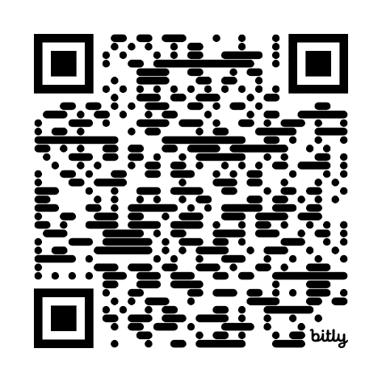
Session Feedback💖
https://bit.ly/dMC2024_SessionFeedback

Slide 28
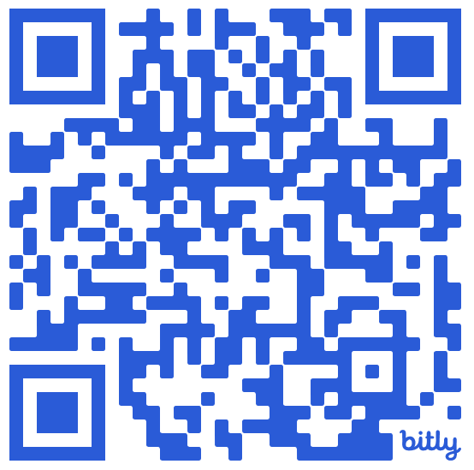
bit.ly/4gJ9JGu

Slide 29

Notes:
Photo by Immo Wegmann on Unsplash
What is the goal of this session

Slide 30

Notes:
Photo by melanfolia меланфолія on Unsplash
This is just my thoughts and ideas
I’m not a professional if you recognise yourself in any of this please ask for help if you think you need it

Slide 31

Notes:
This is just about the journey that I am on and continue to progress on

Slide 32
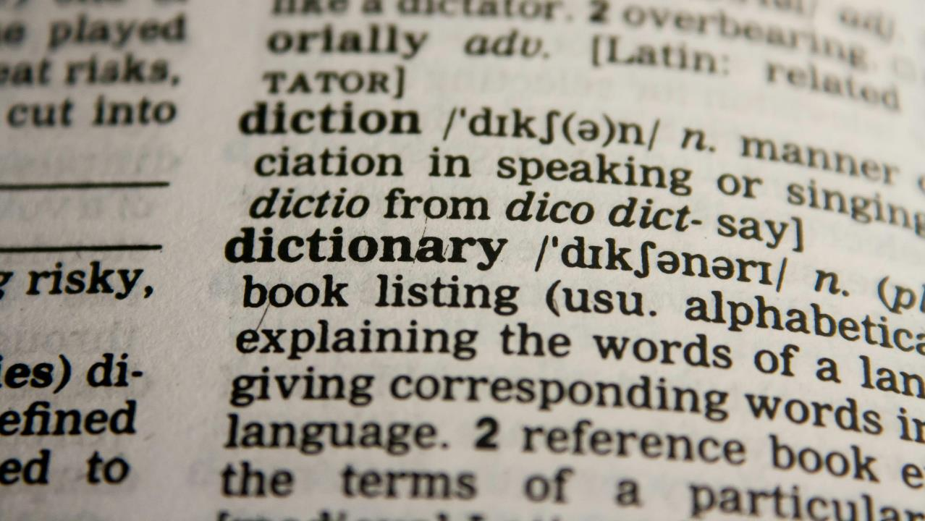

Notes:
Photo by Pixabay: https://www.pexels.com/photo/dictionary-text-in-bokeh-effect-267669/
Lets define it

Slide 33
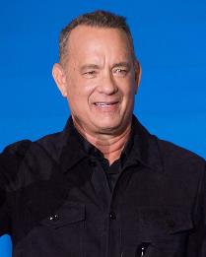
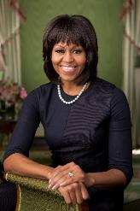
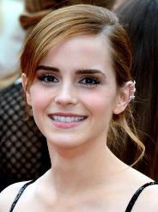
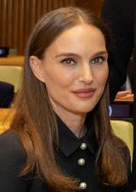

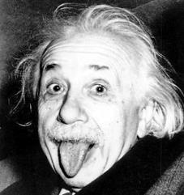

Notes:
Lets talk about people in the public eye who suffer from imposter phenomenon

Slide 34
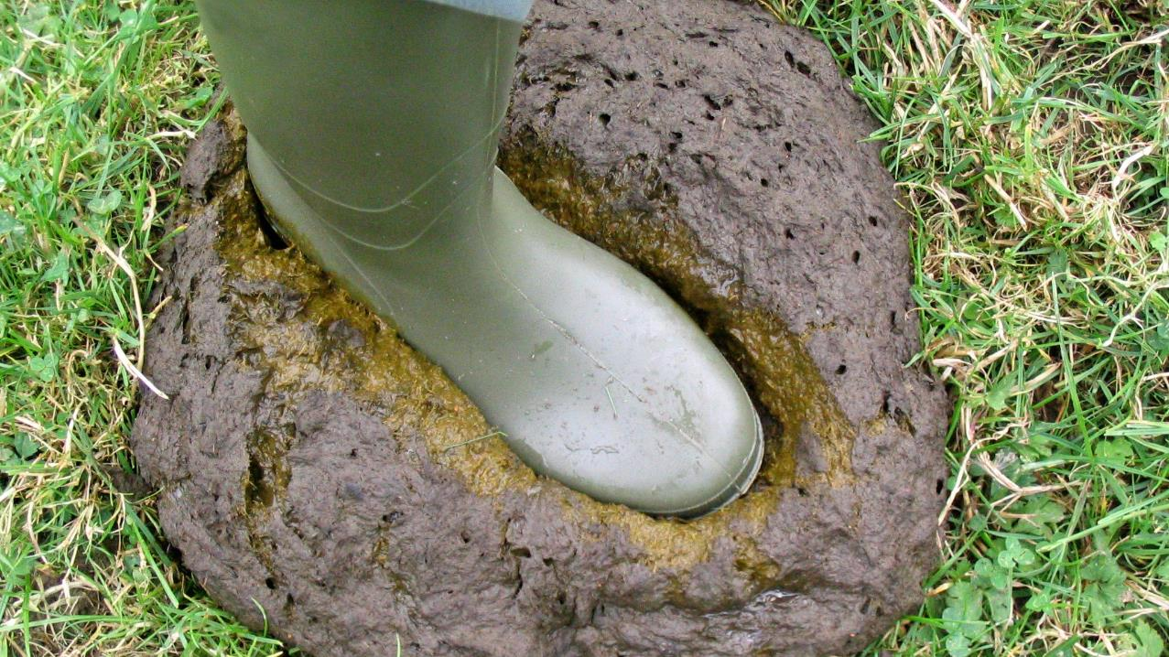

Notes:
https://www.flickr.com/photos/joysaphine/2445439236
Dealing with Bull Shit Bob

Slide 35


Notes:
Photo by engin akyurt on Unsplash
Living with it
What kind of impact does it have on my life?

Slide 36

Compliments

Slide 37
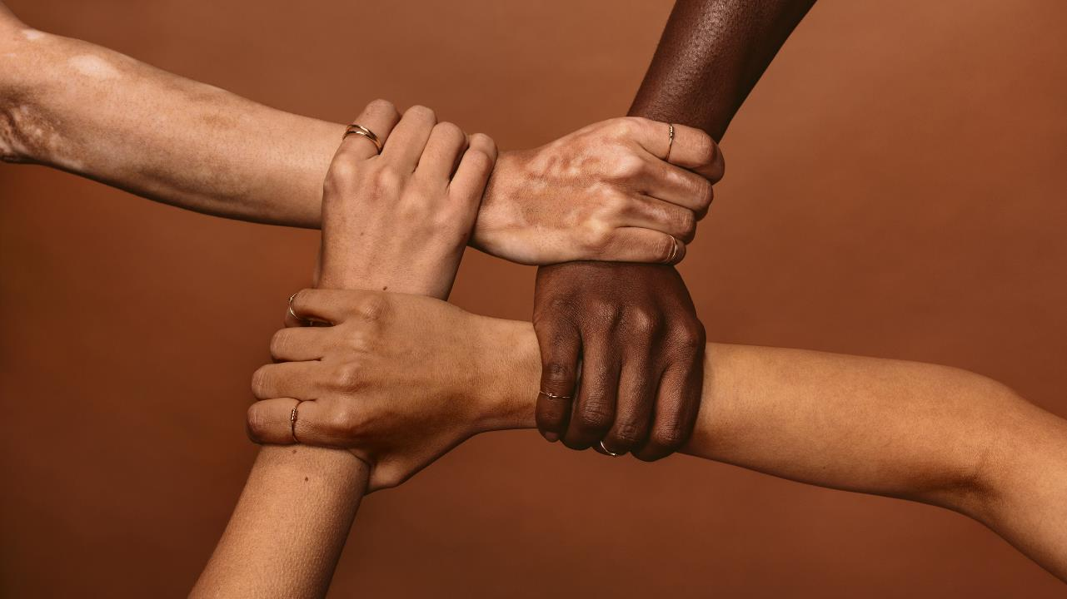

Notes:
What can you do in your team to help?

Slide 38
Find out more

Slide 39
Notes:
Photo by Pixabay: https://www.pexels.com/photo/dictionary-text-in-bokeh-effect-267669/
Lets define it

Slide 40
Also know as
Impostorism
Impostor Phenomenon
Fraud Syndrome

Slide 41

Notes:
Photo by LinkedIn Sales Solutions on Unsplash
History of imposter syndrome
Goes back to the 1970 before the phrase was coined by Pauline R. Clance and Suzanne A. Imes.
"The Impostor Phenomenon in High Achieving Women: Dynamics and Therapeutic Intervention“
.Found both shared that despite academic success had feeling of self-doubt and questioned their abilities
Sounds familiar
Spoke to other successfully women and heard similar experiences

Slide 42
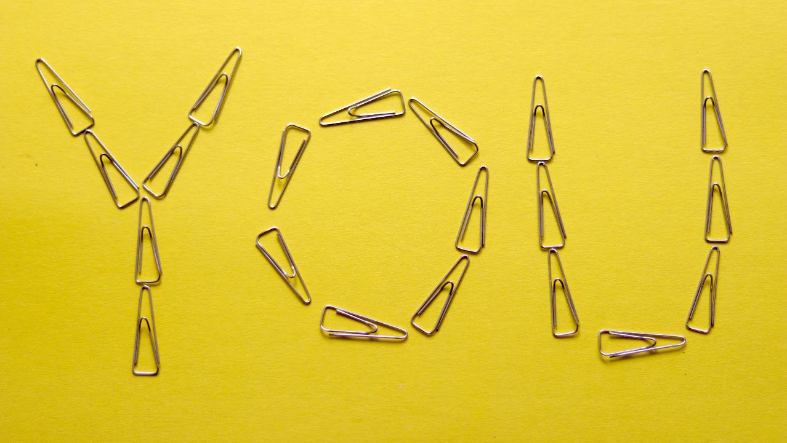
Notes:
Photo by Ben Robbins on Unsplash
Lets talk about you

Slide 43

Notes:
Photo by Lisa Fotios: https://www.pexels.com/photo/person-holding-iphone-1322360/
Lets look at at the different ways imposter syndrome is expressed
Ask yourself do you any of these describe you?

Slide 44

The Perfectionist
Notes:
Photo by Karolina Kaboompics: https://www.pexels.com/photo/typed-message-on-pink-paper-5993378/
Perfectionist
Do you struggle to delegate tasks to others?
Do you feel you must get 100% perfect 100% of the time?
If you miss out on an high score or not get amazing feed back, do you
Consider you are not cut out for that job?
Think about it for days? How you can do better?

Slide 45
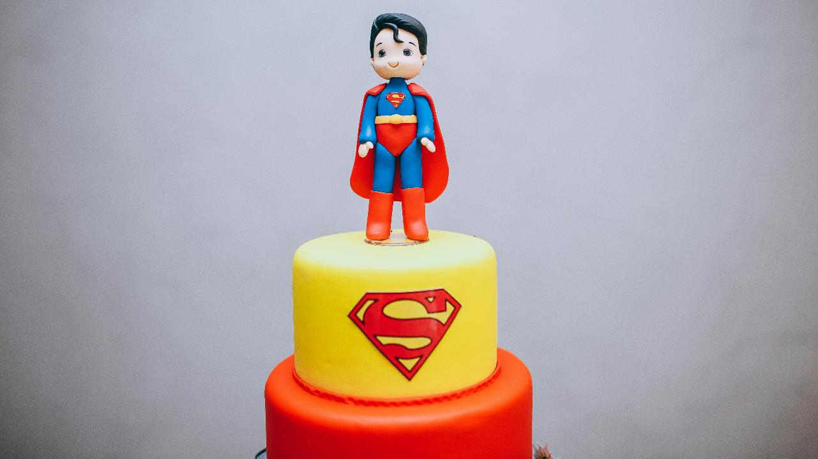
Superwoman or Superman
Notes:
Photo by Helena Lopes: https://www.pexels.com/photo/a-superman-themed-birthday-cake-10336820/
Superwomen / man
Do you stay later than your team, even if completed all the work that day?
Do you get stressed when not working, finding downtime wasteful?
Have you let hobbies and pastimes drop, as they are scarified for work?
Do you feel that you have not earned your title and feel pressured to work harder and longer than others.

Slide 46
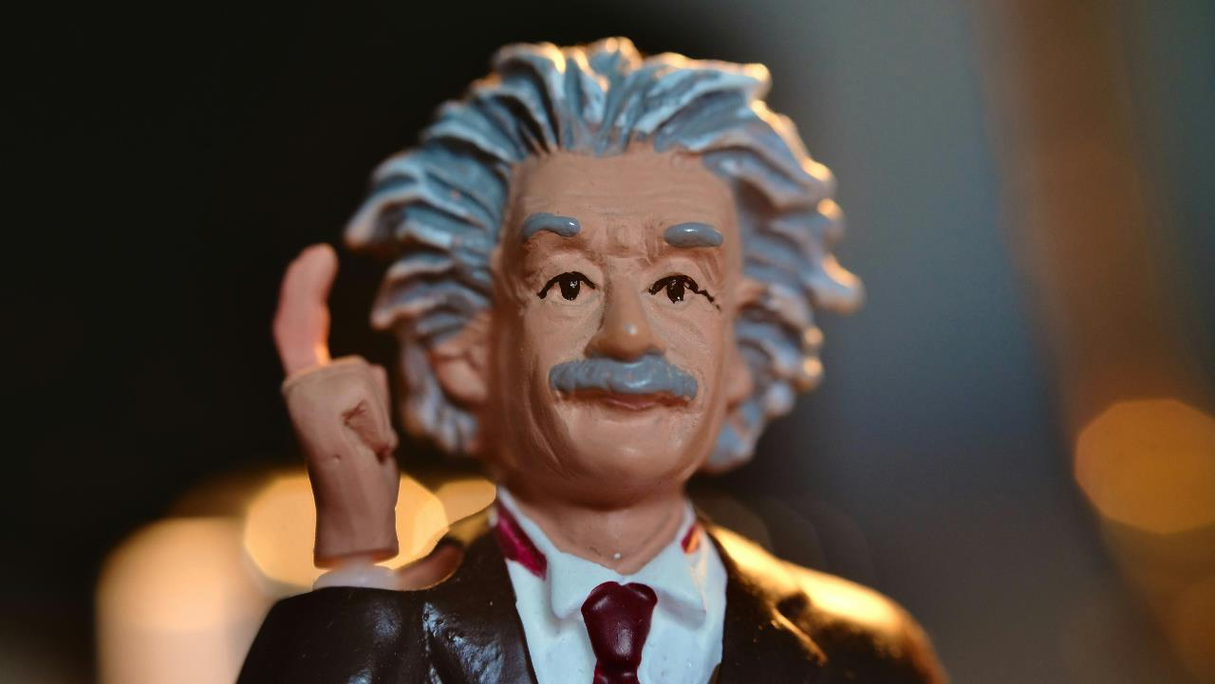
The Natural Genius
Notes:
Photo by Andrew George on Unsplash
The Natural Genius
Do you excel without much effort?
Do you dislike the idea of a mentor because you can handle things on your own?
Does your confident fall when you not preforming well?
Do you avoid challenges because you are uncomfortable trying something you are not good at?

Slide 47
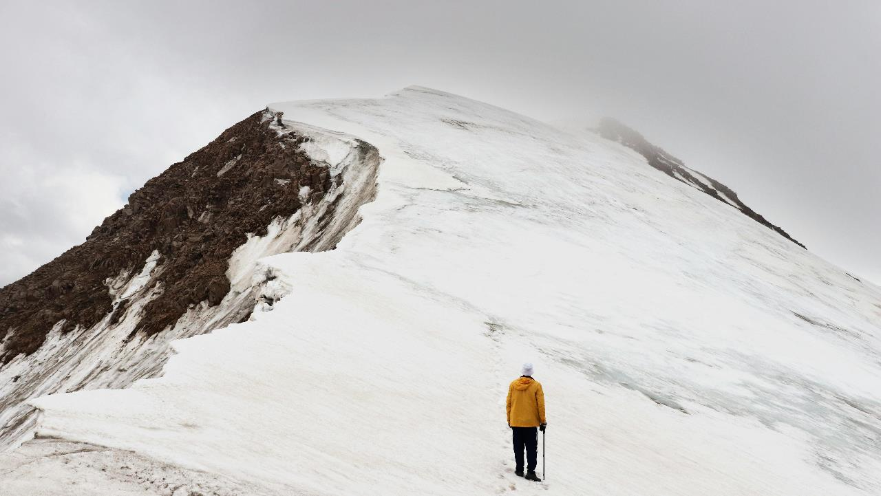
The Soloist
Notes:
Photo by Yevgeniya Fedorova: https://www.pexels.com/photo/man-climbing-snow-covered-hill-1327350/
The soloist
Do you believe you can do anything on your own?
“You do not need anyones help”
Do you frame requests for help in terms of project requirements?

Slide 48

The Expert
Notes:
Photo by Austin Distel on Unsplash
The expert
Only apply for jobs if you meet all the requirements exactly
Constantly looking new certifications or training to improve your skills
Shudder when someone calls you an expert

Slide 49
Notes:
Photo by Lisa Fotios: https://www.pexels.com/photo/person-holding-iphone-1322360/
Did you recognise yourself?
I see a lot of myself in each one!

Slide 50
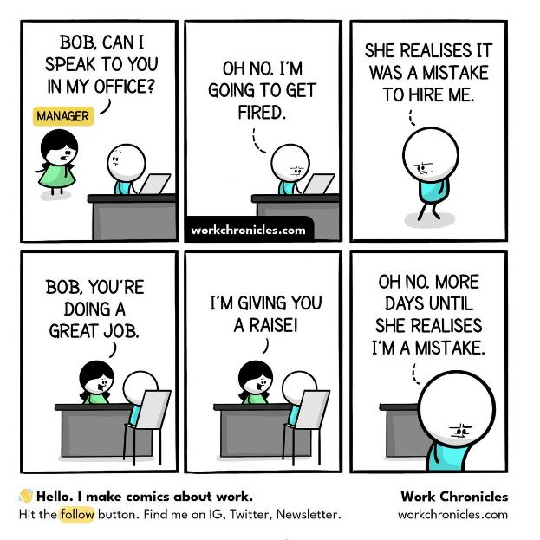

Slide 51
“You’re not alone:
According to a study conducted by Repec,
76.92% of people
experience at least one symptom of imposter syndrome.”
Notes:
Skills assessments and impostor syndrome – TG (testgorilla.com)

Slide 53
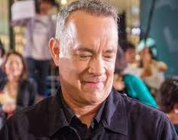
Tom Hanks
Notes:
https://commons.wikimedia.org/wiki/File:Sully_Japan_Premiere_Red_Carpet-_Tom_Hanks_%2829747825731%29.jpg
No matter what we've done, there comes a point where you think, 'How did I get here? When are they going to discover that I am, in fact, a fraud and take everything away from me?
https://www.npr.org/2016/04/26/475573489/tom-hanks-says-self-doubt-is-a-high-wire-act-that-we-all-walk

Slide 54
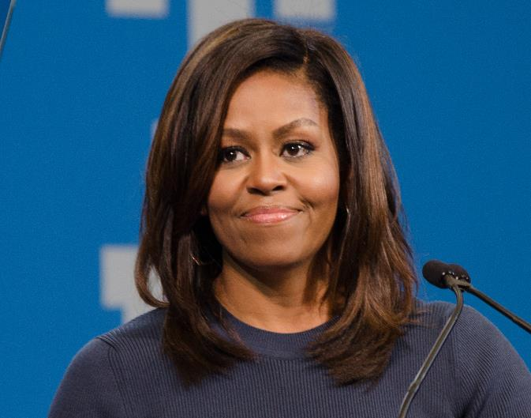
Michelle Obama
Notes:
It doesn't go away, that feeling that you shouldn't take me that seriously. What do I know? I share that with you because we all have doubts in our abilities, about our power and what that power is.
https://www.bbc.co.uk/news/uk-46434147

Slide 55
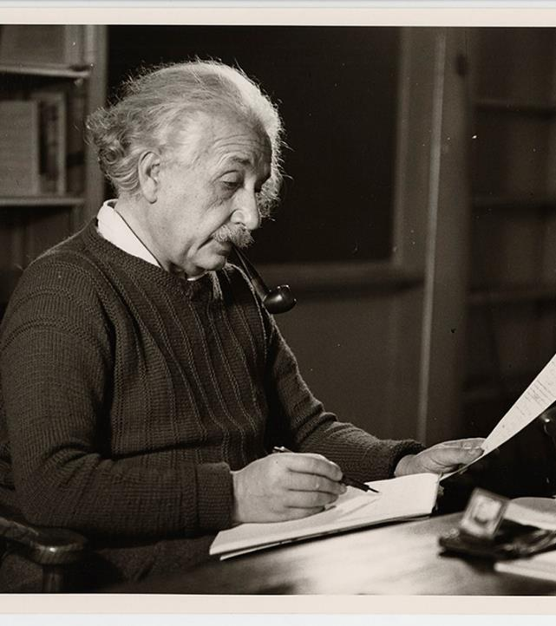
Albert Einstein
Notes:
The exaggerated esteem in which my lifework is held makes me very ill at ease. I feel compelled to think of myself as an involuntary swindler.
https://www.nature.com/articles/529438a

Slide 56

Emma Watson
Notes:
“It’s almost like the better I do, the more my feeling of inadequacy actually increases, because I’m just going, ‘Any moment, someone’s going to find out I’m a total fraud, and that I don’t deserve any of what I’ve achieved.”

Slide 57
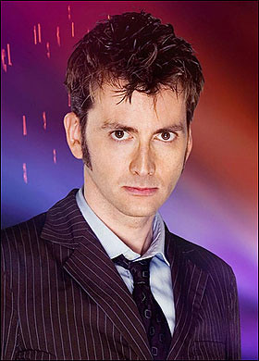
David Tennant
Notes:
It’s worrying about not being good enough, about being found out, about not being worthy as an actor.
http://davidtcontwitter.blogspot.com/2019/05/0526ST.html

Slide 58
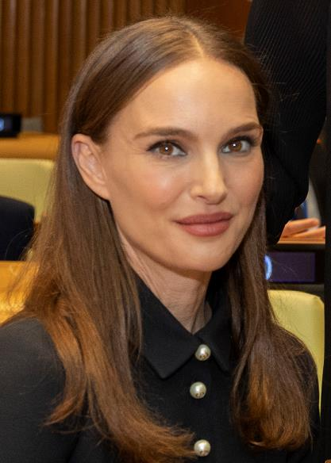
Natalie Portman
Notes:
“Today I feel much like I did when I came to Harvard Yard as a freshman in 1999,” she told the students who had gathered to listen to her. “I felt like there had been some mistake, that I wasn’t smart enough to be in this company, and that every time I opened my mouth I would have to prove that I wasn’t just a dumb actress.”

Slide 59
There are
many more……
Notes:
There even more within the data community
That also suffer from imposter syndrome
Scott Hanselman

Slide 60
Notes:
https://www.flickr.com/photos/joysaphine/2445439236
Dealing with Bull Shit Bob

Slide 61
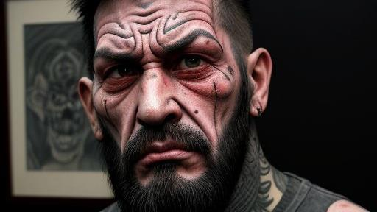

Slide 62
Who is he?
Notes:
This is Bull Shit Bob
My inner critic
The person who spends all their times when they can running my down

Slide 63
What does he say?
Notes:
He is here and will make all the negative comments about situations and people
He is the voice I hear when I hear negative self talk about myself

Slide 64
When do I hear him the most?
Notes:
When I feel most vulnerable and when I feel my imposter syndrome the most

Slide 65

Notes:
Photo by Borta: https://www.pexels.com/photo/black-microphone-in-light-conference-hall-4331578/
Scientific basis for self talk
This is the internal dialogue we all have in our heads about situations and people
Choose to re-frame your internal and external dialogue about you
Visualising situations

Slide 66

Notes:
Photo by John Arano on Unsplash
Self-talk has become one of my strengths.
Its not easy and it requires practice

Slide 67
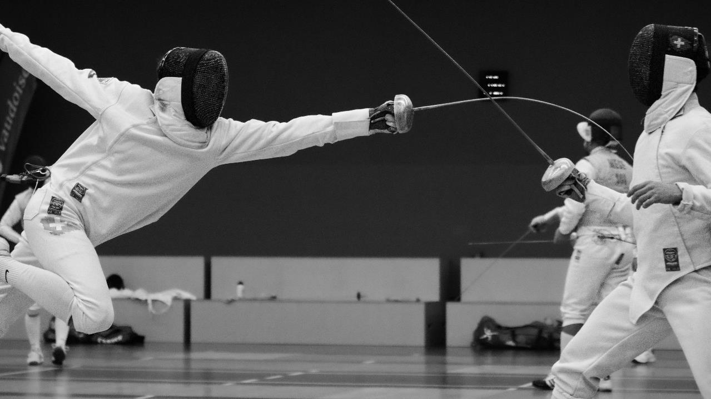
Notes:
Photo by Nathanaël Desmeules on Unsplash
Sometimes I have to reframe the way I talk about situations and events
On one side I have bull shit bob saying one thing
On the other side I have to reframe the situation to get a more positive way of looking at things

Slide 68

Notes:
So what do I mean by negative self talk?
Let me show you some examples

Slide 69
Negative self talk
“I know nothing about that new technology, so I should just avoid it.”

Slide 70
Positive self talk
“What a fantastic chance to learn a new technology, I’m looking forward to it.”
Notes:
Yes you might be scared about learning something new, lots more to learn
Embrace the fear

Slide 71
Negative self talk
“I always make mistakes; I should not even try.”

Slide 72
Positive self talk
“Yes, I sometimes make mistakes. Each mistake gives me a chance to learn.”
Notes:
Yes you might be scared about learning something new, lots more to learn
Embrace the fear

Slide 73
I
Identify
C
Confront
E
Extinguish

Slide 74

Notes:
Photo by Ann H: https://www.pexels.com/photo/photo-of-cubes-with-letters-forming-the-word-repeat-15380264/
For me to use positive self-talk I have to repeat and practice it every day

Slide 75
Notes:
Photo by engin akyurt on Unsplash
Living with it
What kind of impact does it have on my life?

Slide 76


Slide 77

Notes:
Photo by RDNE Stock project: https://www.pexels.com/photo/businessmen-holding-coffee-while-having-conversation-8124226/
Tell someone at least one person you TRUST

Slide 78
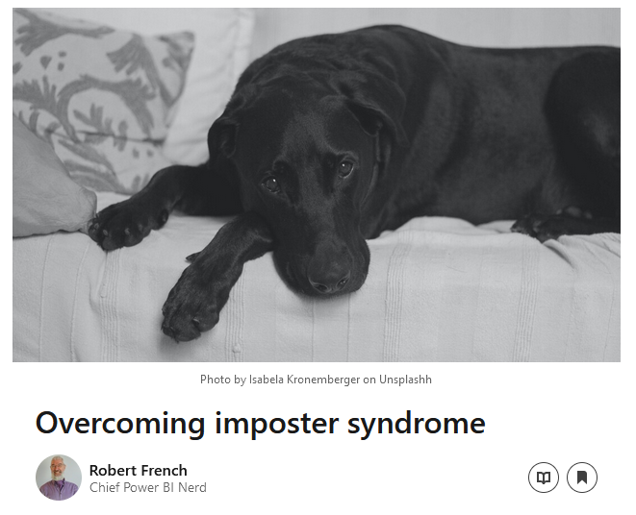
Notes:
I was amazed at the response!

Slide 79
“That’s how I feel….”
Notes:
This is what people said to me, then they read the article I was not alone in feeling that way.

Slide 80


Notes:
Photo by Ralph Katieb on Unsplash
I had to learn that I’m unique and different, not quite like anyone else
Part of that is my imposter phenomenon

Slide 81

Notes:
Photo by Harry Tucker: https://www.pexels.com/photo/back-view-of-visitor-wearing-mickey-ears-at-disneyland-28561866/
Learned over time that I’m not like everyone else, I’m unique and that’s ok

Slide 82

Notes:
Photo by Guillaume de Germain on Unsplash
Being unique, different and accepting it can be a super power

Slide 83

Notes:
Photo by Pixabay: https://www.pexels.com/photo/books-in-black-wooden-book-shelf-159711/
Going to talk about creating a library of facts

Slide 84
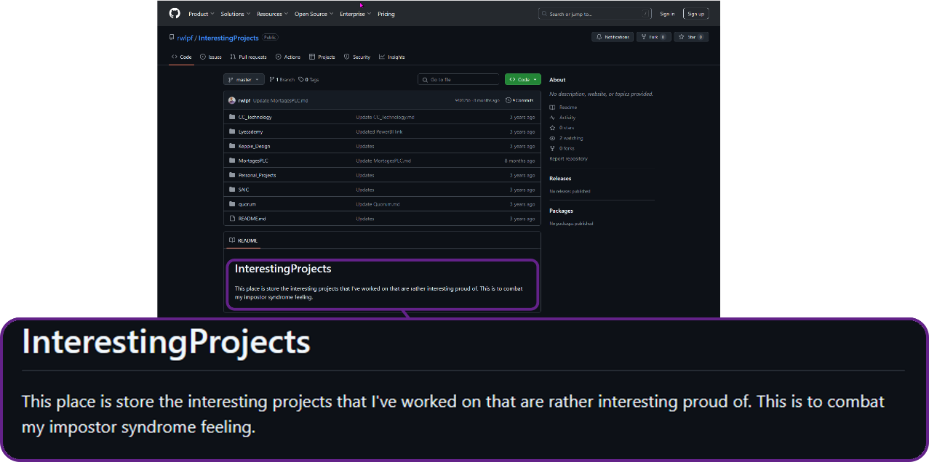

Slide 85

Notes:
Photo by Ann H: https://www.pexels.com/photo/white-text-on-white-background-15368257/
So why do this ?

Slide 86

Notes:
Photo by Hartono Creative Studio on Unsplash
Its easy to let you negative emotions and self talk influence you in the wrong way

Slide 87

Notes:
Photo by Tingey Injury Law Firm on Unsplash
Want to rebalance the scales

Slide 88
Facts
Notes:
I cannot argue with Facts they are real
Sometimes I forget what I have done
These facts when I read them remind me of what did.

Slide 89

Notes:
What I include

Slide 90

One of my passions outside of technology is cycling, and this has led to an interest in the Tour de France, one of the most recognisable professional cycle races in the world. Some datasets list the winners and times. That said, these do not include all the finishers for each stage of the race; typically, they only have the top 10 finishers and results.
While looking at various websites, I found https://www.procyclingstats.com, which lists all the finishers for each stage going back to the first race. The next step was to choose the right web scraping technology to extract the results. After careful consideration, I settled on using Python and Beautiful Soup to scrape the website. The data scraped from the website is then written to a set of tables hosted in an SQL server database.
Project Title –
Web Scraping Tour De France results
Notes:
This is an

Slide 91

Notes:
Photo by Tim Gouw on Unsplash
Was it easy to build the library of facts?
No it was not

Slide 92

Notes:
Photo by Jill Wellington: https://www.pexels.com/photo/silhouette-photography-of-jump-shot-of-two-persons-40815/
It was worth the effort

Slide 93

Notes:
Photo by CHUTTERSNAP on Unsplash
T

Slide 94
Failure
Notes:
Photo by CHUTTERSNAP on Unsplash
Dealing with failure has been part of my journey

Slide 95

Notes:
TBH I do not like to fail just ask anyone who works or lives with me

Slide 96

Notes:
Photo by Andrea Piacquadio: https://www.pexels.com/photo/man-in-pink-dress-shirt-3777568/
I get angry when I make a mistake !

Slide 97

Notes:
Photo by Pixabay: https://www.pexels.com/photo/letter-blocks-247819/
What I have learned?

Slide 98

Notes:
Photo by Max van den Oetelaar on Unsplash
I'm learning to breath....

Slide 99
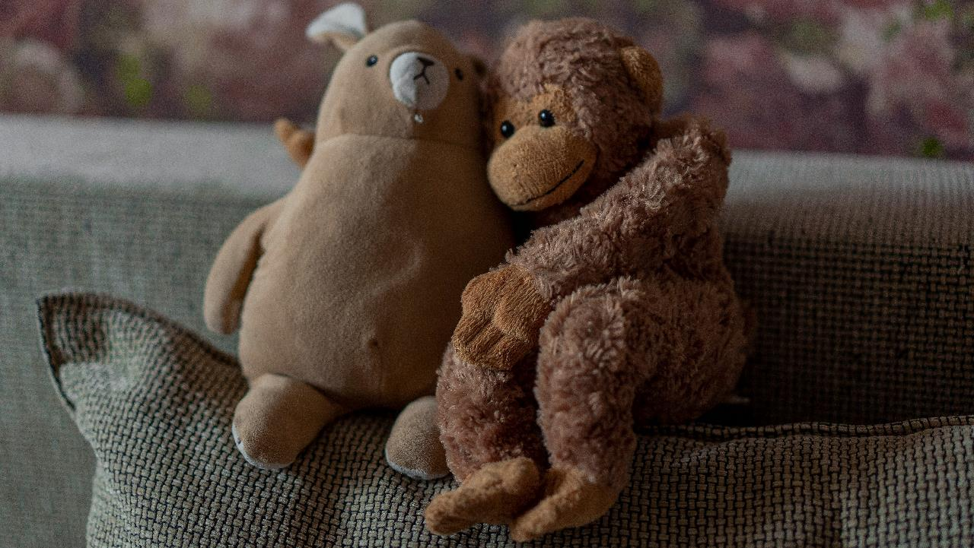
Notes:
Photo by Anastasiia Krutota on Unsplash
First thing is to be kind to myself, thing can and do fail

Slide 100
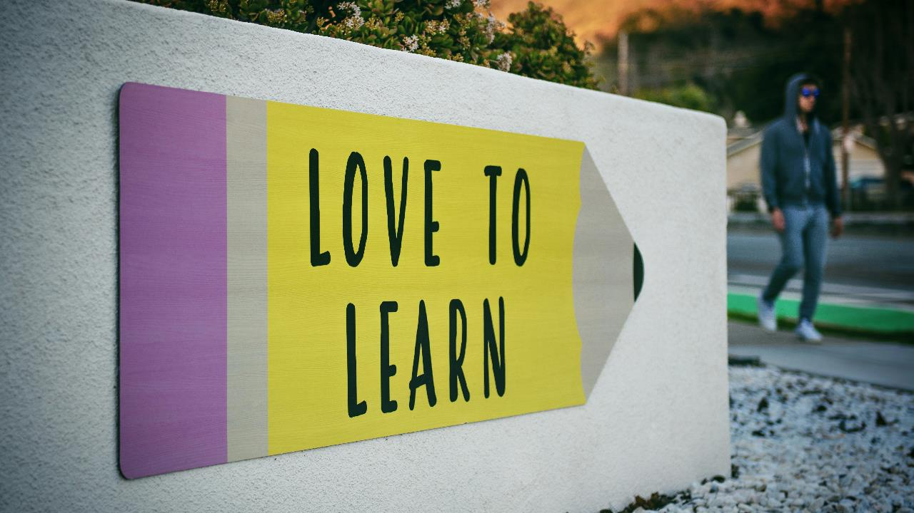
Notes:
Photo by Tim Mossholder on Unsplash
Learn from the situation – what can I learn?

Slide 101
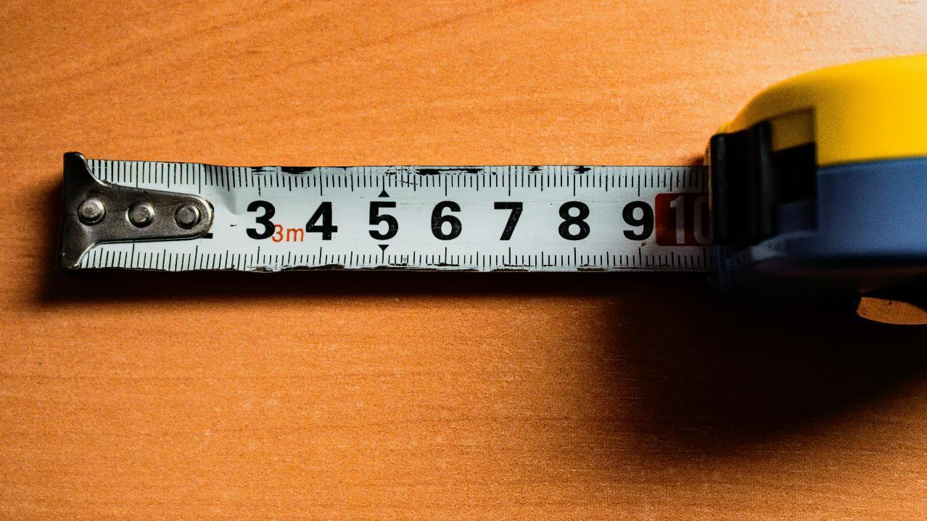
Notes:
Photo by Mark Wilkinson Hughes on Unsplash
I’m not measured or judged by my mistakes

Slide 102
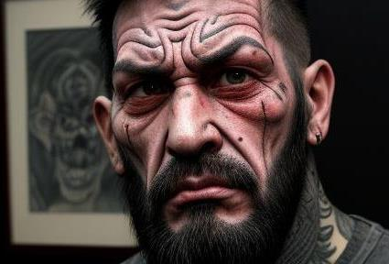

Slide 103
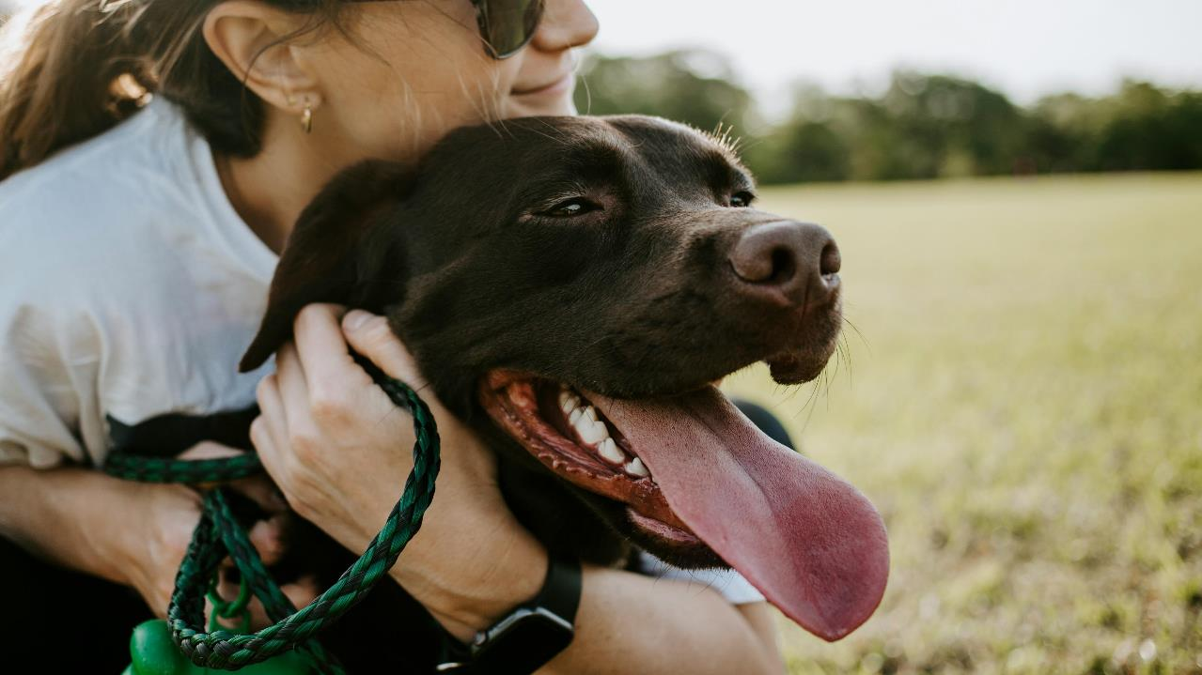
Notes:
Photo by Wade Austin Ellis on Unsplash
What would you best friend say to you if you made a mistake?
Say that then repeat

Slide 104
Compliments

Slide 105
Compliment
a remark that expresses approval, admiration, or respect:
Notes:
Lets start off defining it
We all know when we hear one, or even better when we get one

Slide 106
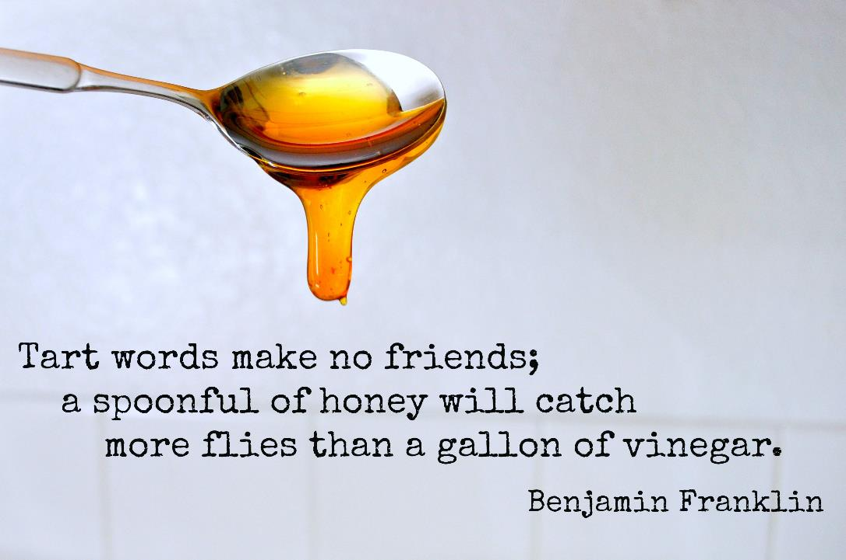

Slide 107
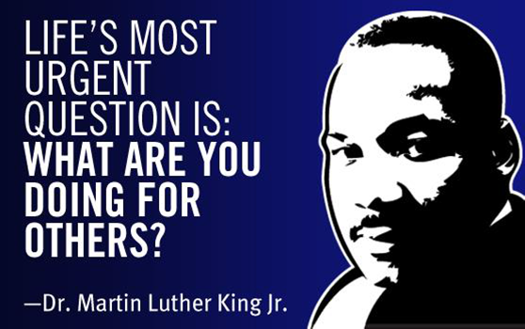
Notes:
What do compliments for others

Slide 108

Source
Notes:
Compliments can boost peoples self confidience

Slide 109

Notes:
Maybe some people do not believe me yet?

Slide 110

Notes:
Think about a compliment you received
How did it make you feel?
How did feel for the next couple of minutes / hour/ day

Slide 111

Notes:
It does and can make a difference to how you feel
https://www.flickr.com/photos/pantera-rosa/5926389312/in/photolist-a2Gi55-pMv2Z9-g3Dqwo-bttZkC-fWXbQC-KmCgh-5nMg9D-9q45GN-ak3yBH-nG8SYw-e4X2Qa-CiRb5o-shFvPt-qKtuyS-Tq3cNZ-nfUXYP-8WPEu6-78tWEj-efzET5-5jwS9n-mXzE56-csneAy-b75XAz-di5Aaz-waYVoR-eMFe1K-Lx45v-72BDhm-rYwSLx-8gQKrf-28TNDf-6huoZU-ZkPyQA-7q9CSD-WB4LAY-6nuioZ-dPPjW8-26Q4Mev-ng1t1C-9YxS1D-6AwU3o-dkEymU-7Hynhx-dc9EWW-jMwwSa-ourUSe-JwGZNs-ovdRWj-71igLv-6Ct16X

Slide 112

Notes:
Be specific with the compliment not general
Not “you look nice”
Compliment something they have rather than physical appearance unless you other half which is very different
Did they complete a physical task ?
Did they do something well eg tackling a difficult technical challaning

Slide 113
Be genuine
Notes:
If you see something that you feel should be complemented
Do not wait make the complement

Slide 114

Notes:
Use peoples name, especially if you do not know them
Peoples names are very powerful your compliment is directed at THEM

Slide 115


Slide 116

Notes:
Be on the look out for things to compliment
The more you look for them the easier it is to find them

Slide 117
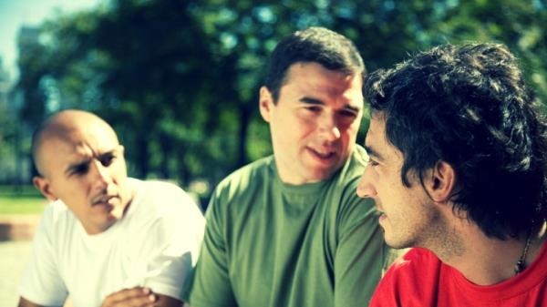
Notes:
If you heard a compliment 2nd hand
PASS IT ON, you get the credit and the recipient feels good
Win – Win situation

Slide 118


Slide 119


Notes:
Compliment waiting staff story about two restaurants in Oban
Robin and chefs at Gleneagles

Slide 120
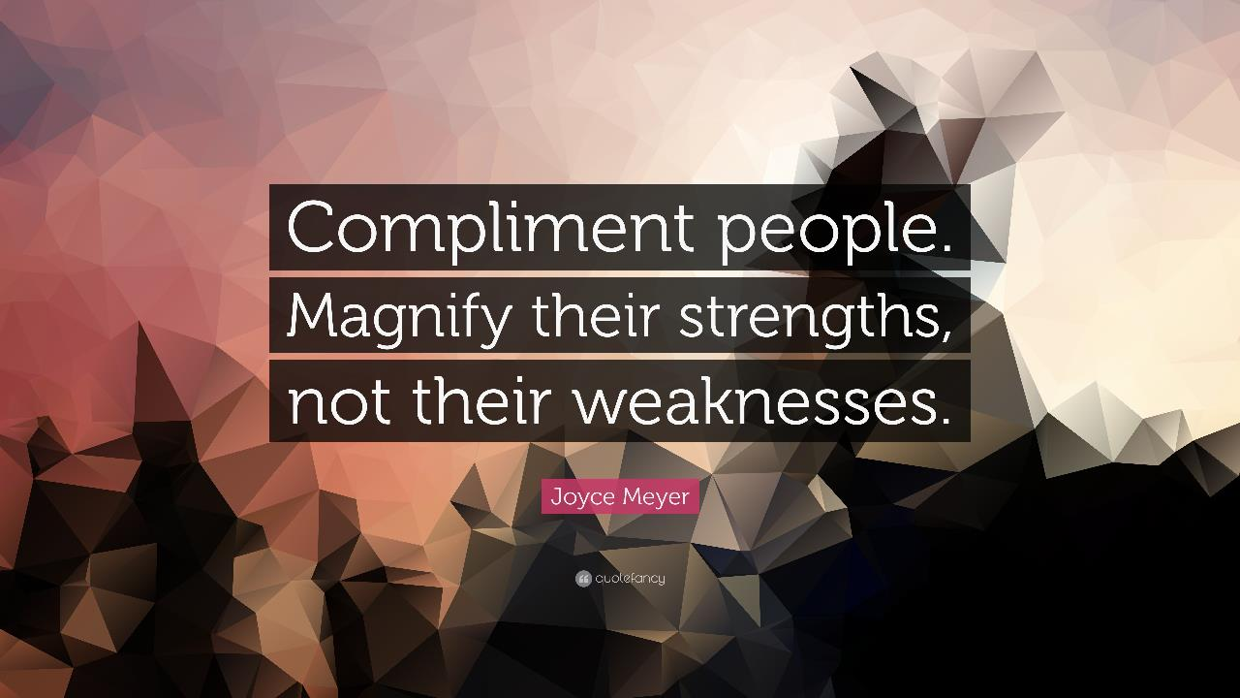

Slide 121
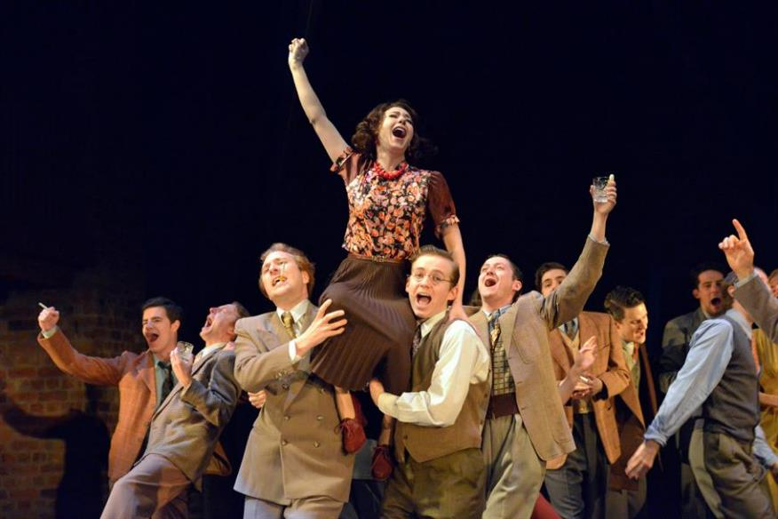
Will the other person feel good?
Notes:
If you comment does not make the other person feel better do not say it

Slide 122

Notes:
Photo by Alexas_Fotos on Unsplash
Yet just saying thank you and accepting a compliment is so hard for me, and my current lesson.

Slide 123
But…

Slide 124

Notes:
Photo by Andrea Piacquadio: https://www.pexels.com/photo/desperate-evicted-male-entrepreneur-standing-near-window-3771129/
This is my one of my current lessons

Slide 125

Notes:
Photo by Kira auf der Heide on Unsplash
Accepting a compliment is like getting a gift,
I do not find it easy accept, I‘m learning to slowly

Slide 126
Notes:
What can you do in your team to help?

Slide 127

Notes:
Encourage people to open and honest about how they feel, more people probably feel the same way

Slide 128

Notes:
Photo by Finn Hackshaw on Unsplash
Foster open communication
It can be intimidating if team members don’t know where to ask questions or who to approach. Without a clear sense of team and communication norms, team members can have a hard time overcoming that initial hurdle. This uncertainty can fuel impostor feelings and make individuals feel like they don't belong.
To help, managers can set up a time to sit with team members and answer any questions they have. For example, make sure to cover:
Which tool to use when?
Who should they go to if they have questions?
Team conventions for things like asking questions during meetings
A communication plan reduces the guesswork and lowers the barrier to entry for easier communication.

Slide 129

Notes:
Empathy – let them know its ok
Demonstrate empathy and understanding when team members express feelings of inadequacy. Let them know that these feelings are normal and that you value their contributions.

Slide 130

Notes:
Positive Reinforcement: Provide regular, positive feedback to acknowledge your team's accomplishments. This can help boost their confidence and counteract negative self-talk.
Share feedback early and often
More often than not, imposter syndrome isn’t based on the reality of a team member’s situation. Sometimes, feedback—both positive and constructive—helps team members get a better sense of how they’re doing.

Slide 131

Notes:
Photo by Mikael Kristenson on Unsplash
Encourage continuing develop
Encourage experimentation
Encourage a growth mindset

Slide 132

Notes:
Photo by Larissa Gies on Unsplash
Check in frequently
Consider implementing a check-in during your 1:1 meetings, offering a place for the team member to share how they’re doing. When managers are transparent about their personal experiences, it encourages team members to do the same.

Slide 133

Notes:
Photo by Jan Kahánek on Unsplash
Encourage them to keep the library of facts eg positive feed back things they did well

Slide 134

Notes:
Photo by sydney Rae on Unsplash
Self care
Encourage employees to look after themselves
In particular mental health – people with imposter phenomon are not good at looking after ourselves some times

Slide 135
Notes:
Photo by Pixabay: https://www.pexels.com/photo/dictionary-text-in-bokeh-effect-267669/
Lets define it

Slide 137
Notes:
https://www.flickr.com/photos/joysaphine/2445439236
Dealing with Bull Shit Bob

Slide 138
Notes:
Photo by engin akyurt on Unsplash
Living with it
What kind of impact does it have on my life?

Slide 140
Notes:
Photo by Ralph Katieb on Unsplash
I had to learn that I’m unique and different not quite like anyone else

Slide 141
Notes:
Photo by Pixabay: https://www.pexels.com/photo/books-in-black-wooden-book-shelf-159711/
Going to talk about creating a library of facts

Slide 142
Failure
Notes:
Photo by CHUTTERSNAP on Unsplash
Dealing with failure has been part of my journey

Slide 143
Compliments

Slide 144
Notes:
What can you do in your team to help?

Slide 145

Notes:
Photo by olia danilevich: https://www.pexels.com/photo/confetti-on-a-piece-of-paper-8127308/

Slide 146
Notes:
Photo by Pixabay: https://www.pexels.com/photo/letter-blocks-247819/

Slide 147
Find out more

Slide 148
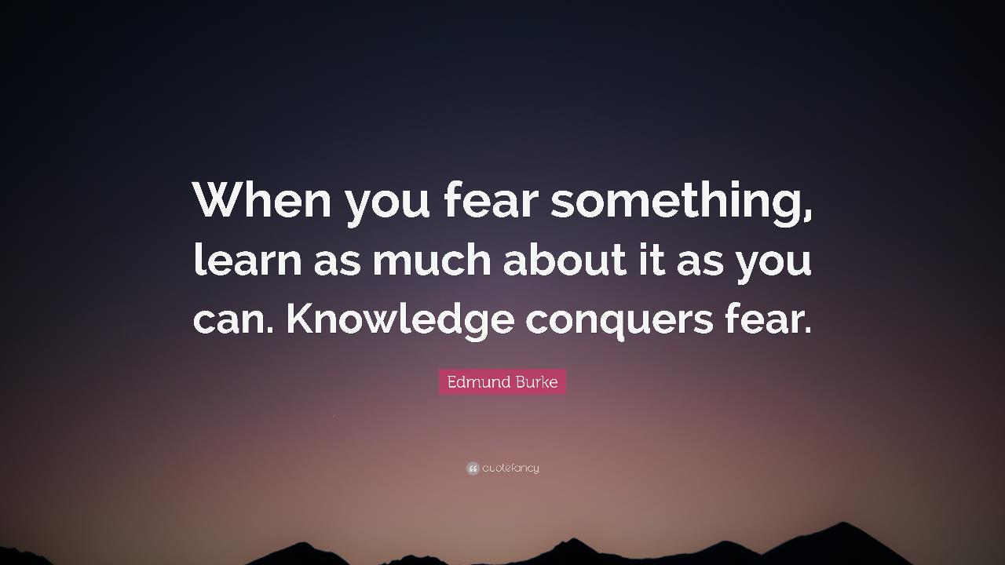
Notes:
https://quotefancy.com/media/wallpaper/3840x2160/2183754-Edmund-Burke-Quote-When-you-fear-something-learn-as-much-about-it.jpg

Slide 149
bit.ly/4gJ9JGu

Slide 150


Slide 151
Robert French
Chief Power BI Nerd at Quorum
Lives in Sunny Glasgow, Scotland
rwlp.french@gmail.com
@sqlbobscot
https://www.linkedin.com/in/rwlpfrench/
https://www.qnrl.com/

Slide 152

Notes:
Two final thoughts

Slide 153
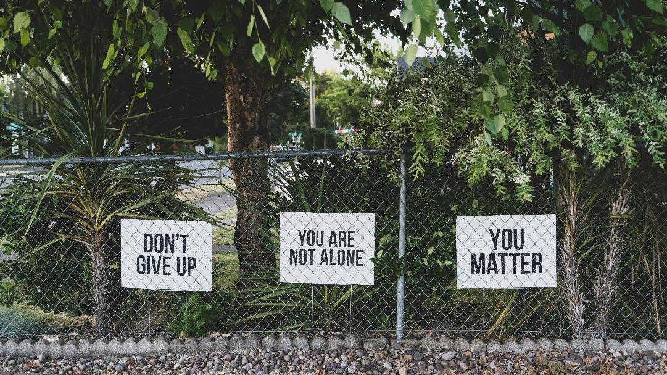
Notes:
Photo by Dan Meyers on Unsplash

Slide 154
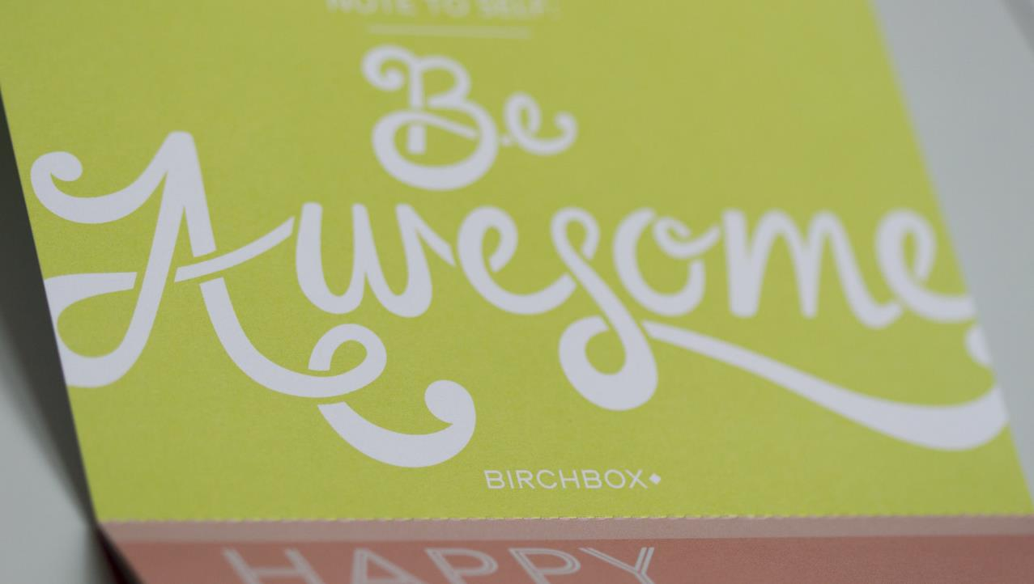
Notes:
https://www.flickr.com/photos/terrio/12608344674/

